Slide 1
Divide, Conquer, Recursion
Timothy E. Roe, Jr.
Mr. R. Stevens
AP Computer Science A

Slide 2
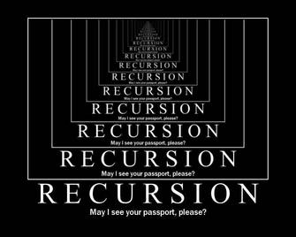
Principles of Recursion
Recursion: (n.) the repeated application of a recursive procedure or definition.
Recursion is the ability to repeat things in a similar but a way that is not exactly the same.
This allows us to look at detailed things that are small but happen over time.

Slide 3
“In order to understand recursion, one must first understand recursion.”
–Anonymous

Slide 4


Examples of Recursion
Some changes one might see in Recursion include
Size
Weight
Height
Recursion allows someone to look at things at a logical standpoint and think of the different things that can happen when something is altered.

Slide 5
Recursion in Code
An Example of Recursion would be something like a piecewise function.
Piecewise Function: a piecewise-defined function (also called a piecewise function or a hybrid function) is a function which is defined by multiple sub functions, each sub function applying to a certain interval of the main function's domain (a sub-domain).

Slide 6
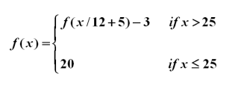
Recursion in Code
Given the following definition for f(x), evaluate f(30).
How do we do this in Java…?

Slide 7
The first thing you want to do is create a new method or write a block of code that calculates for each portion of the piecewise function
In this example I will call for the Class: piecewiseExample
public class piecewiseExample {
piecewiseExample() {
}
public int fOf(double x) {
if (x <= 25) {
System.out.println(x + " <= 25, therefore ... f(" + x + ") = 20");
return 20;
}
else {
System.out.println(x + " > 25, therefore ... f(" + x + “/12+5) - 3 = f(“+(x/12+5) + ") - 3");
return fOf(x/12+5) - 3;
}
}
}

Slide 8
The second thing we want to do is call the method in our tester class file.
Our Class in this Example is PiecewiseToRecursionMethod
public class PiecewiseToRecursionMethod {
public static void main(String[] args) {
int x;
piecewiseExample example = new piecewiseExample();
}

Slide 9
Now we set x to the number we are evaluating in f(x). In this case the x = 30.
public class PiecewiseToRecursionMethod {
public static void main(String[] args) {
int x;
piecewiseExample example = new piecewiseExample();
x = 30;
}

Slide 10
Now we call for the function example.fOf(x)in our main class file
public class PiecewiseToRecursionMethod {
public static void main(String[] args) {
int x;
piecewiseExample example = new piecewiseExample();
x = 30;
System.out.println("f(" + x + ") = " + example.fOf(x));
System.out.println();
}

Slide 11
And if you were to run this program the expected output you should see is:
30.0 > 25, therefore ... f(30.0/12 + 5) - 3 = f(7.5) - 3
7.5 <= 25, therefore ... f(7.5) = 20
f(30) = 17

Slide 12
And That’s Recursion!

